Slide 1
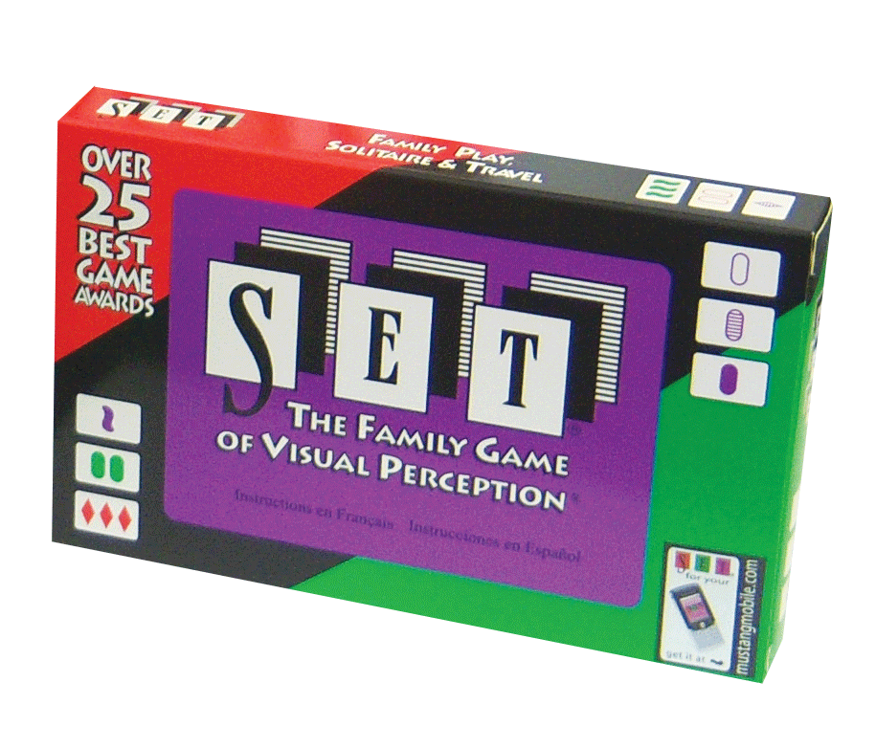
Teaching Neural Networks to Play SET™️
Metis DL Module Presentation
Andrei Levin • 12/3/21

Slide 2
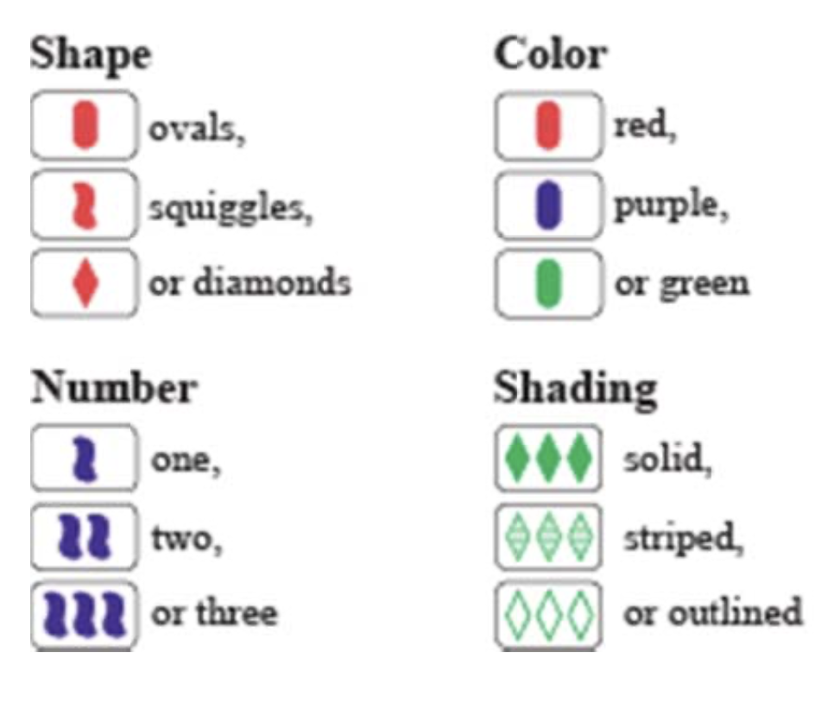
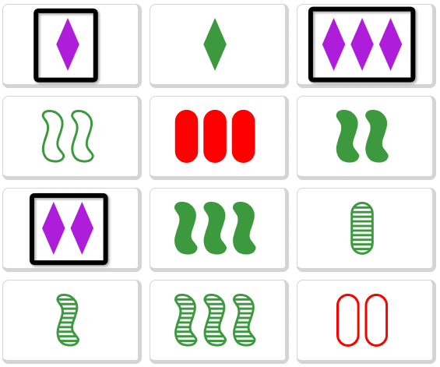

SET is a Pattern-Finding Card Game
• Each card has 4 features:
Shape, Color, Number, Shading
• Each feature has 3 classes

Slide 3
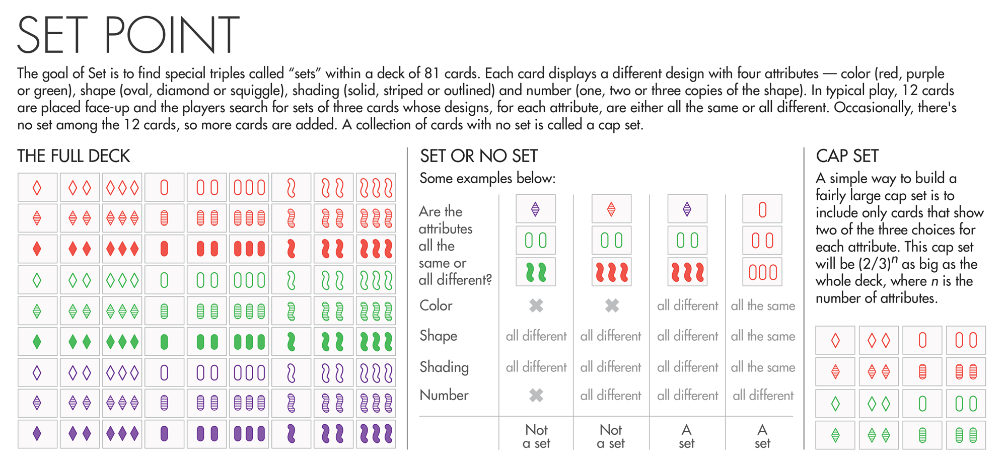
A Full Deck Has 3^4 = 81 Different Cards
• Each card has 4 features:
Shape, Color, Number, Shading
• Each feature has 3 classes

Slide 4
The Goal of the Game is to Find Sets
• Three cards are said to form a Set if, for each feature:
the cards are all the same class OR all different classes
Shading | All same | All different | All different
Shape | All same | All different | All different
Color | All same | 2 & 1 | All different
Number | All different | 2 & 1 | All different
Is it a Set? | Yes ☺ | No ☹ | Yes ☺

Slide 5
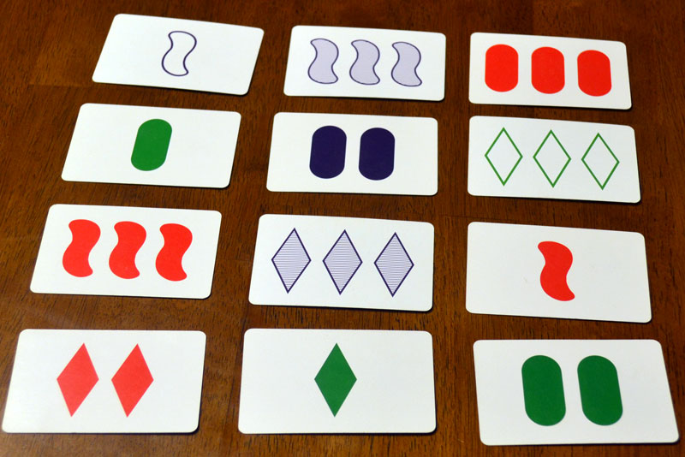
Can You Find the Sets in This Hand?

Slide 6

Can We Teach a Computer to Find the Sets?
(1) Collect many card images
(different lighting, backgrounds, angles, etc.)
(2) Train four separate classifiers: one for each attribute
(3) Combine the classifiers to fully identify the card
(4) Exhaustive algorithm to find all Sets in a hand
Color Classifier
"Green"
Number Classifier
"Three"
Shading Classifier
"Solid"
Shape Classifier
"Squiggle"

Slide 7
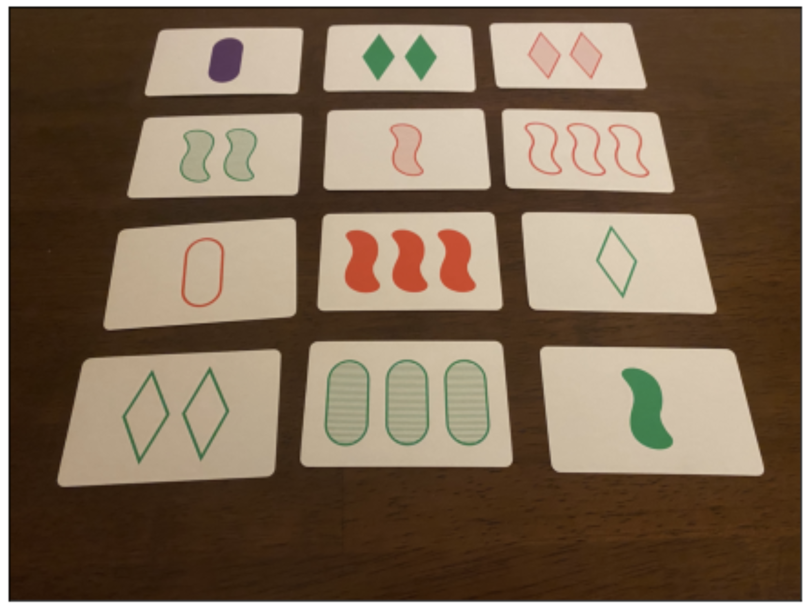
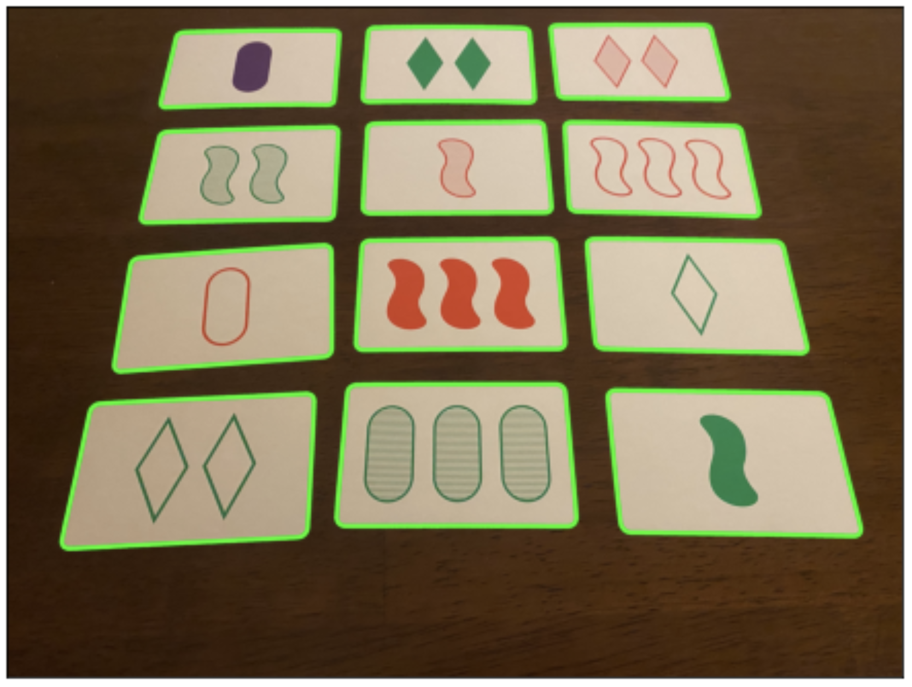
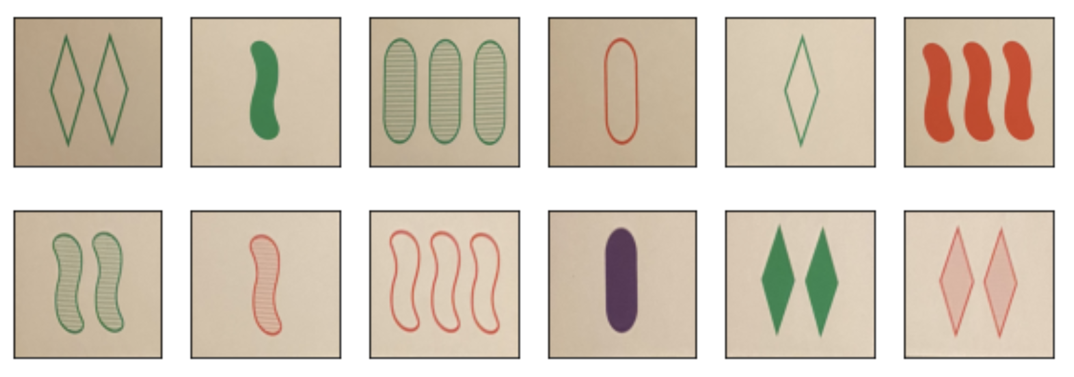
Getting the Training Data: OpenCV
1 Take Photos 2 Detect Contours 3 Extract Cards
1
2
3

Slide 8
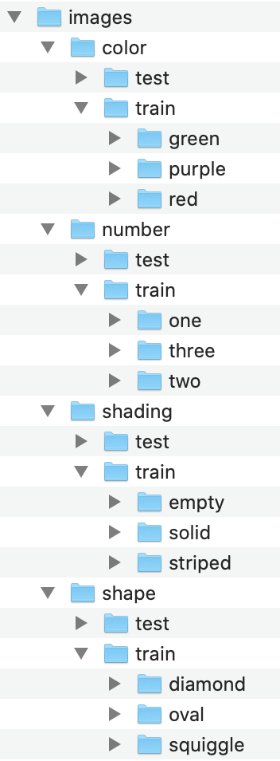
Data Augmentation
• Collected 540 unique images (140 per class)
• 420 unique training images
→ 4-fold augmentation (90 degree rotations)
→ 1680 naturally augmented training images

Slide 9
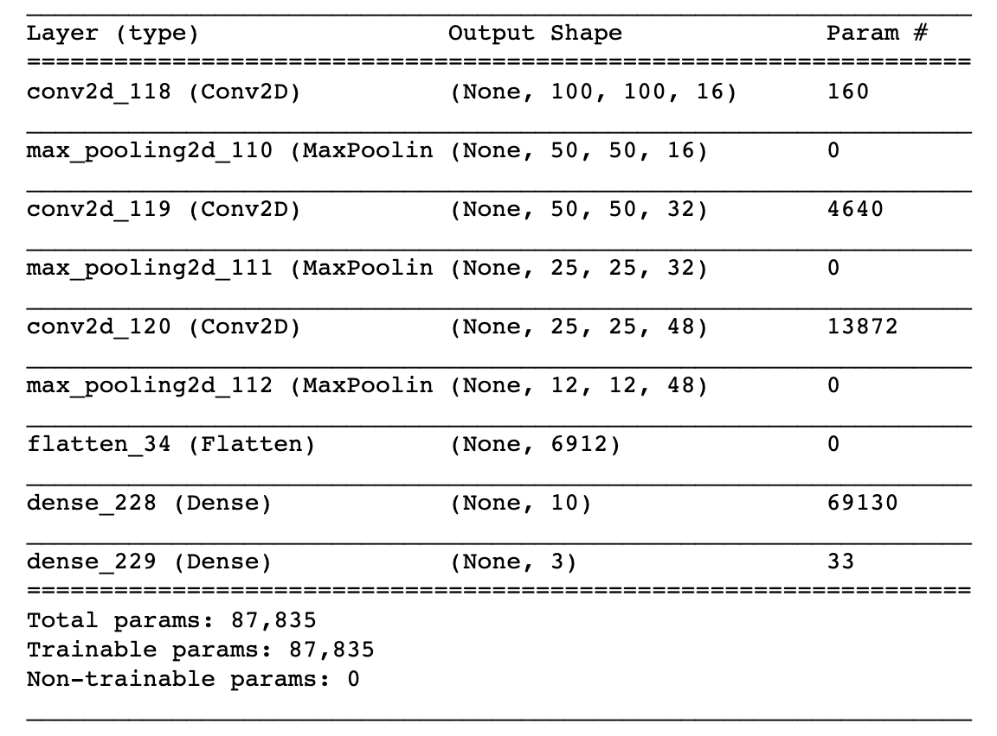
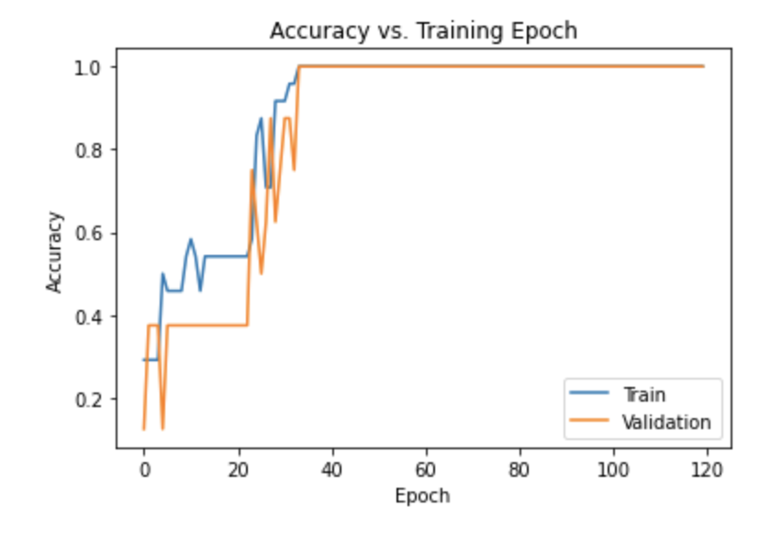

Number Classifier: 100% Train/Valid/Test Accuracy!
Color, Shape, Shading Classifiers:
~50%-80% Test Accuracy

Slide 10
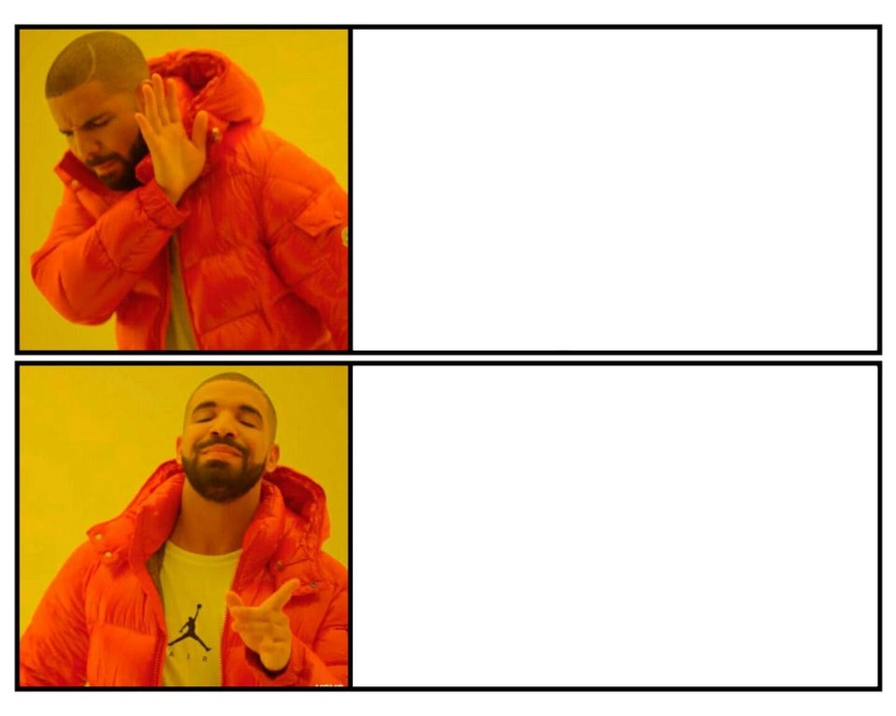
Conclusions
Teaching
a neural net to
play SET
Teaching
a neural net to
count to three
Teaching
a neural net to count to three
Next Steps
• Further data augmentation (e.g. brightness, blurring)
• Hyperparameter tuning • Hierarchical classifiers
• Regularization • Different model architectures

